Slide 1



GLADIATOR GADKO
18.10.2023
Celebrating
15 YEARS
HIRING PLATFORM

Slide 2

TEAM DETAILS
HARBOURING TOMORROW’S TALENT
TEAM MEMBERS
ANU S DEEPAN R DEEPSIKASRI R G
GRACELIN JONAX E KOWSALYA M
MENTOR
MURALI G

Slide 3
PROBLEM STATEMENT
In today's dynamic job market, the hiring process is often complex and time-consuming.
While employers struggle to efficiently evaluate potential candidates, candidates face challenges in finding the right job opportunities at right time.
The need is evident for a streamlined hiring platform that simplifies test creation, test-taking, and one-on-one interview scheduling.

Slide 4
SOLUTION
Develop a user-friendly online hiring platform that enables administrators to create and manage tests, candidates to take these tests, and matches successful candidates with interviewers based on their expertise and interests.
Time consumption for hiring process in our platform is low and candidates who pass the contest will be scheduled for interview with employees based on their interests and employees' expertise to ensure effective hiring process.
Our solution also have ML tool to monitor unethical behavior of candidates during contest.
Candidates will be scheduled to the employees automatically for their interviews.

Slide 5
TECH STACK, ASSUMPTIONS & CONSTRAINTS
We used reactjs and react router, fontawesome, codemirror, apexchart, react redux packages from node modules for frontend, spring boot and spring security for backend and tensorflow for Machine Learning.
We encountered challenges during our project, such as learning new concepts, integrating the backend and frontend, addressing cross-origin errors in Spring Security, and designing the database architecture. We successfully navigated these challenges through a combination of trial and error and guidance from our mentor.
We chose React for its component-based architecture, making it ideal for building a user-friendly and responsive web interface.Spring Boot was selected due to its strong security features and support for building robust RESTful APIs. PostgreSQL was chosen due to its reliability, scalability, and compatibility. We opted for TensorFlow for machine learning due to their rich libraries and established capabilities for data analysis and anomaly detection.

Slide 6
SCALABILITY AND USABILITY
The platform's technology stack is well-suited to our team's expertise, which will contribute to a smooth and efficient implementation.
Our platform implements data encryption and access controls to safeguard candidate and employee information. This commitment to data security not only ensures compliance with privacy regulations but also builds trust among users, enhancing the platform's effectiveness.
In the future, we plan to offer a wider variety of coding languages in the coding round, allowing candidates to choose the language they are most comfortable with and we also plan to further enhance our ML tool for more sophisticated detection and prevention of unethical behavior.

Slide 7
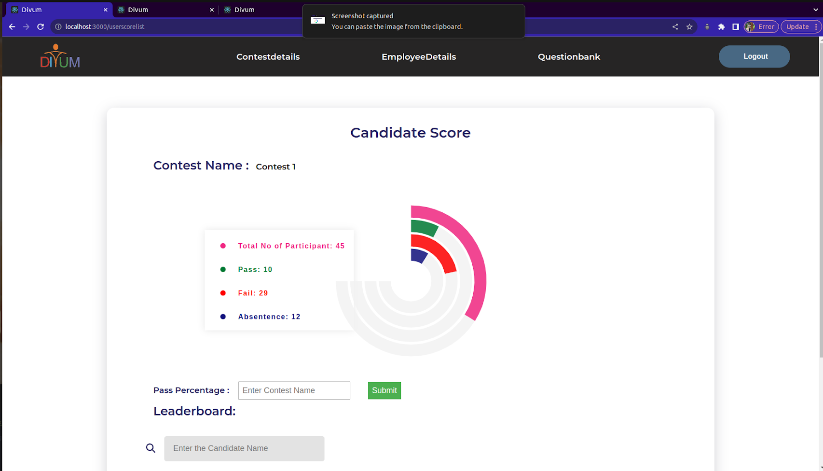
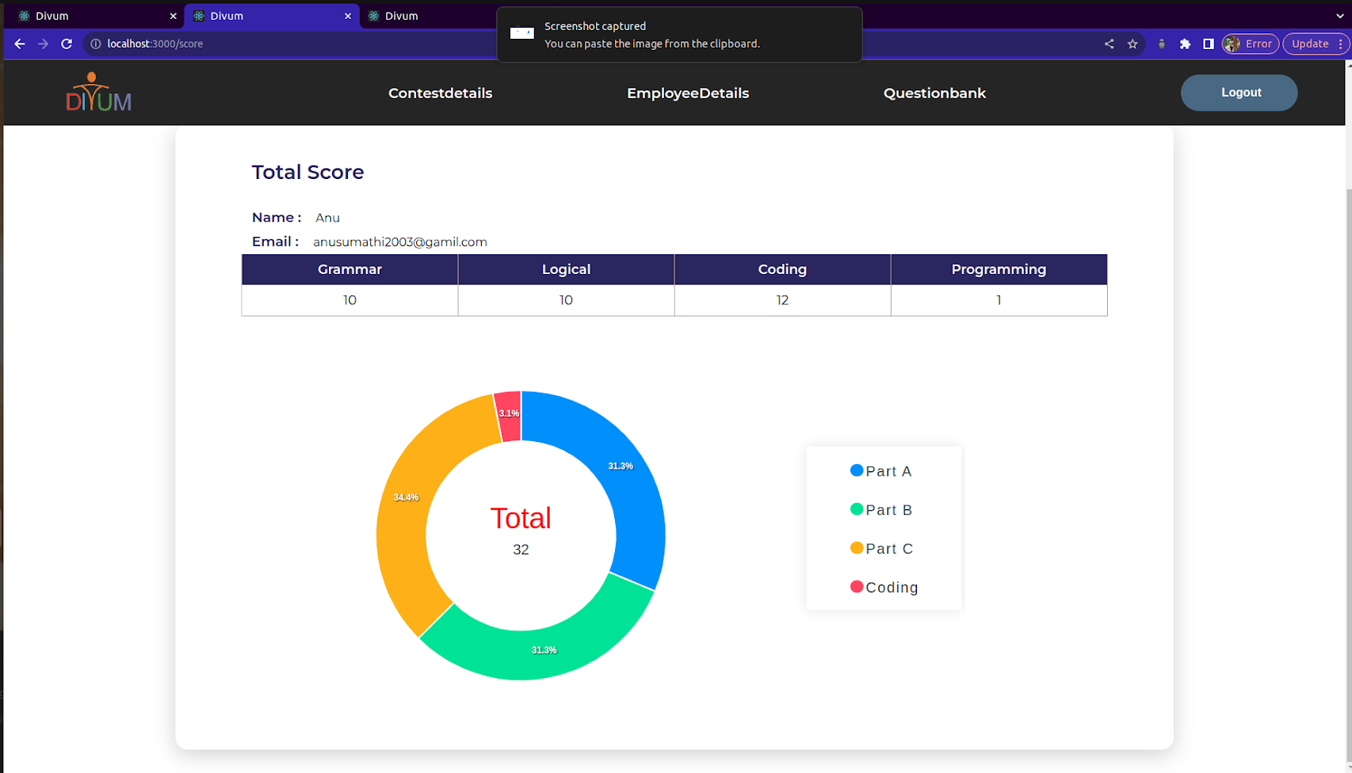
DEMO

Slide 8
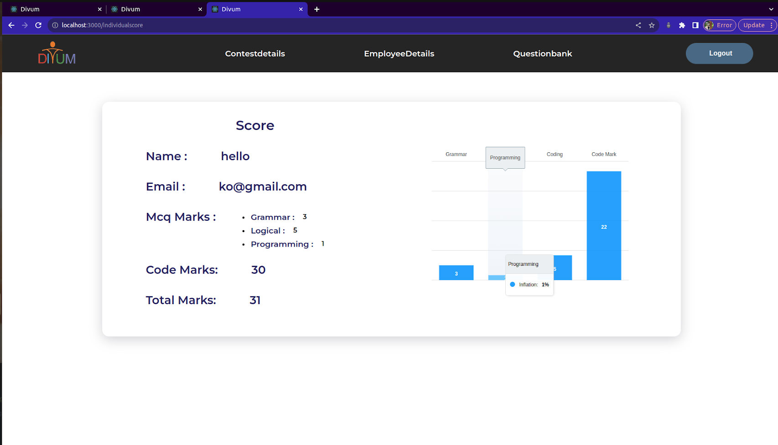
DEMO

Slide 9
THANKS
Celebrating
15 YEARS

